Slide 1

BLOOD BANK MANAGEMENT SYSTEM
Department of Big data analytics
Submitted to :
Mr. Suresh Kumar Choudhary
Submitted by :
Pawan bisht
2018MSBDA006

Slide 2
Table of Content :
Contents | Page no.
Introduction | 3
Objective | 4
Features | 5
Entity description | 6
Entity-Relationship diagram | 9
Schema mapping | 10
Normalization | 11
Creation of database using MY SQL. | 14
Test Cases | 25
Conclusion | 27
References | 28

Slide 3
INTRODUCTION:
The project blood bank management system is known to be a pilot project that is designed for the blood bank to gather blood from various sources and distribute it to the needy people who have high requirements for it.
This system is designed to handle the daily transactions of the blood bank and search the details when required.
It also helps to register the details of donors, blood collection , blood bank details.
This system is designed in such a manner that it can suit the needs of all the blood bank requirements in the course of future.

Slide 4

OBJECTIVE :
The goal of blood management is to ensure the safe and efficient use of the many resources involved in the complex process of blood component therapy.
This blood transfusion service is to provide effective blood and blood components which are as safe as possible and adequate to meet the patient’s needs.

Slide 5
FEATURES :
Registration of Donors
Blood Donation
Need based request processing ( Fresh Blood and Stored Blood ) cancellation
Returning of issued blood bags
Transfusion Details
Inter Bank Transactions
Checking availability of blood bank nearest to your location.

Slide 6
ENTITY DESCRIPTION :
Blood Bank :This entity represents the details of blood bank.
Attributes (Branch_id ,Branch_name ,Branch_address ,Contact_no.)
Employee :This entity represents the detail about the employees who are going to manage the blood bank services.
Attributes (E_id , Ename ,Age ,Address ,Salary ,Contact_no. ,Designation)
Donor :This entity represent the detail of person who donates their blood.
Attributes(D_id ,D_name ,Date ,Age ,Contact_no ,Address ,Email)
Blood Request :This entity represent the detail of requests for blood by patient or any hospital.
Attributes(Request_id,Quantity ,mbile_no ,Bd_group,Confirmation, Amount )

Slide 7
ENTITY DESCRIPTION (Contd.) :
Patient : This entity represents detail of patient who needed blood.
Attributes( P_id ,P_name ,Patient_disease ,Hospital ,Blood_group )
Medical Report : This entity represents medical report of the donor.
Attributes (Report_id, Bloodgroup , Diseases )
Stock : This entity represents the stock houses of the bank and the availability of the blood.
Attributes (Stock_id ,Stock_name ,Bloodgroup ,Quantity )

Slide 8
Entity – Relationship Details :
Blood Bank has Employees to manage them.
Blood Bank has their respective stocks.
Blood Bank has Donors who donates their blood.
Blood Bank has blood request by some patient or by some hospital.
Donors have their respective medical report.

Slide 9
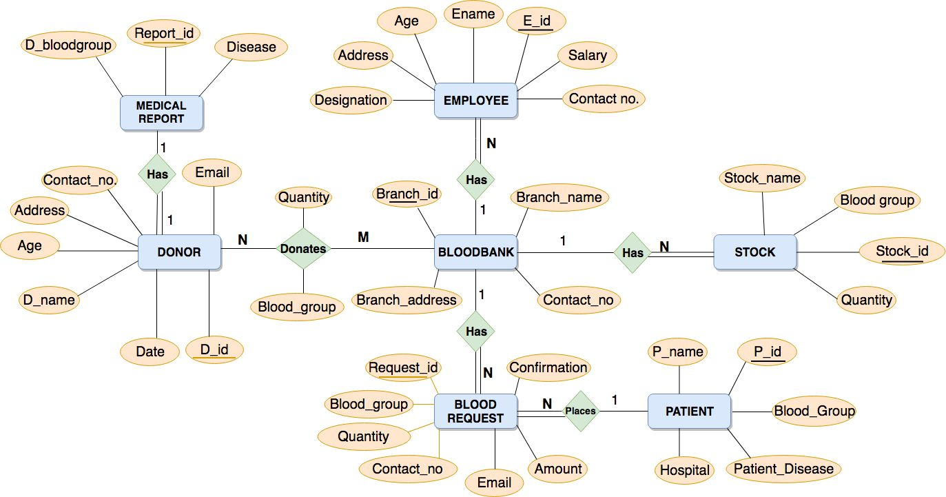
Entity-Relationship Diagram

Slide 10
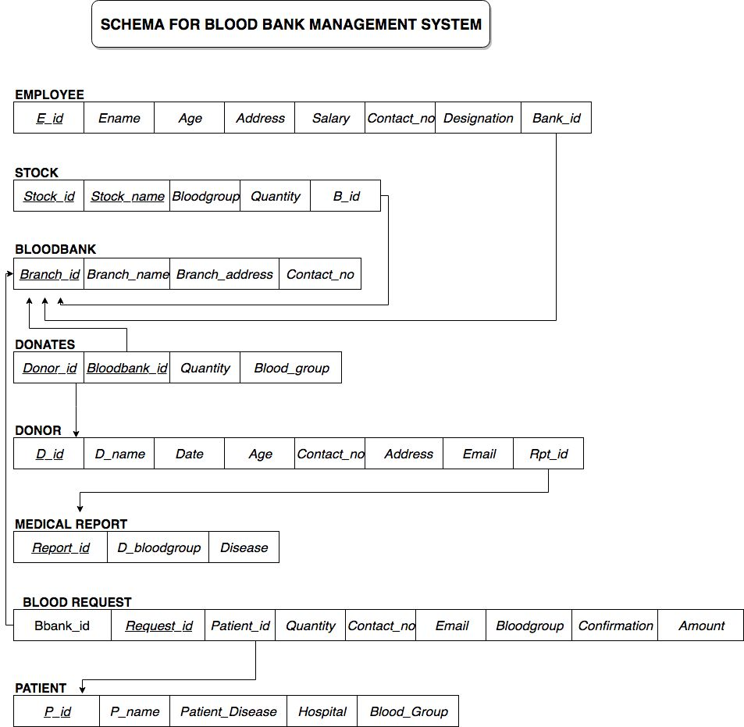

Slide 11
NORMALIZATION :
Blood Bank :
Functional Dependency :
Branch_id (Branch_name ,Branch_address ,Contact_no)
Blood Bank is in 3NF and BCNF.
Employee :
Functional Dependency :
E_id (Ename ,Age ,Address ,Designation ,Contact_no ,Salary)
Employee is in 3NF and BCNF.
Donor :
Functional Dependency :
D_id (D_name ,Age ,Address ,Contact_no. ,Email ,Date)
Donor is in 3NF and BCNF.

Slide 12
NORMALIZATION (Contd.) :
Blood Request :
Functional Dependency :
Request_id (Quantity ,Blood_group ,Contact_no ,Email ,Confirmation ,
Amount)
Blood Request is in 3NF and BCNF.
Patient :
Functional Dependency :
P_id (P_name ,Hospital ,Blood_group ,Patient_Disease)
Patient is in 3NF and BCNF.
Stock :
Functional Dependency :
Stock_id (Stock_name ,Blood_group,Quantity)
Stock is in 3NF and BCNF.

Slide 13
NORMALIZATION (Contd.) :
Donates :
Functional Dependency :
(Donor_id ,Bloodbank_id ) (Blood_group ,Quantity)
Donates is in 3NF and BCNF.
Medical Report :
Functional Dependency :
Report_id (D_bloodgroup ,Disease)
Medical Report is in 3NF and BCNF.

Slide 14
SQL QUERY :
mysql> CREATE TABLE Blood_Bank (
-> Branch_id varchar(100) NOT NULL,
-> Branch_name varchar(100),
-> Branch_address varchar(100),
-> Contact_no varchar(100),
-> PRIMARY KEY( Branch_id));
mysql> CREATE TABLE Employee(
-> E_id varchar(100) NOT NULL,
-> Ename varchar(100),
-> Age integer,
-> Address varchar(100),
-> Salary varchar(100),
-> Contact_no varchar(100),
-> Designation varchar(100),
-> Bank_id varchar(100),
-> PRIMARY KEY( E_id),
-> FOREIGN KEY( Bank_id) REFERENCES Blood_Bank ( Branch_id));

Slide 15
SQL QUERY (Contd.) :
mysql> CREATE TABLE Stock(
-> Stock_id varchar(100) NOT NULL,
-> Stock_name varchar(100),
-> Bloodgroup varchar(5),
-> Quantity varchar(20),
-> B_id varchar(100),
-> PRIMARY KEY( Stock_id),
-> FOREIGN KEY( B_id) REFERENCES Blood_Bank ( Branch_id));
mysql> CREATE TABLE Medical_Report (
-> Report_id varchar(100) NOT NULL,
-> D_bloodgroup varchar(5),
-> Disease varchar(100),
-> PRIMARY KEY( Report_id));

Slide 16
SQL QUERY (Contd.) :
mysql> CREATE TABLE Donor(
-> D_id varchar(100) NOT NULL,
-> D_name varchar(100),
-> Date varchar(100),
-> Age integer,
-> Contact_no varchar(100),
-> Address varchar(100),
-> Email varchar(100),
-> Rpt_id varchar(100),
-> PRIMARY KEY( D_id),
-> FOREIGN KEY( Rpt_id) REFERENCES Medical_Report ( Report_id));
mysql> CREATE TABLE Donates(
-> Donor_id varchar(100),
-> Bloodbank_id varchar(100),
-> Quantity integer,
-> Blood_group varchar(100),
-> PRIMARY KEY( Donor_id ,Bloodbank_id ),
-> FOREIGN KEY( Donor_id) REFERENCES Donor( D_id),
-> FOREIGN KEY( Bloodbank_id) REFERENCES Blood_Bank ( Branch_id));

Slide 17
SQL QUERY (Contd.) :
mysql> CREATE TABLE Patient(
-> P_id varchar(100) NOT NULL,
-> P_name varchar(100),
-> Patient_Disease varchar(100),
-> Hospital varchar(100),
-> Blood_Group varchar(5),
-> PRIMARY KEY( P_id ));
mysql> CREATE TABLE Blood_request (
-> Request_id varchar(100) NOT NULL,
-> Bbank_id varchar(100),
-> Patient_id varchar(100),
-> Quantity integer,
-> Contact_no varchar(100),
-> Email varchar(100),
-> Bloodgroup varchar(5),
-> Confirmation varchar(5),
-> Amount integer,
-> PRIMARY KEY( Request_id),
-> FOREIGN KEY( Bbank_id ) REFERENCES Blood_Bank (Branch_id),
-> FOREIGN KEY( Patient_id) REFERENCES Patient( P_id ));

Slide 18
SQL QUERY (Contd.) :
INSERT INTO blood_bank VALUES ( ‘B1','Samarpan blood bank‘ ,'Jaipur‘ , '282552‘ ),( 'B2‘ ,'Jan Suvidha blood bank‘ ,'Ajmer‘ ,'284423‘ ),( 'B3‘ ,'Burari blood bank‘ ,'Amer‘ ,'223912');
INSERT INTO Employee VALUES ( 'E1’ ,' Abhishek kumar‘ ,23 ,'Kekri,Rajasthan‘ ,'50000‘ ,'7210282911‘ ,'Manager‘ ,'B1‘ ),( 'E2‘ ,'Atul joshi‘ ,22 ,'Sunderkhal ,Uttarakhand‘ ,'50000‘ ,'8476282911‘ ,'Manager‘ ,'B2‘ ),( 'E3‘ ,'Anurag Sharma ‘ ,24 ,'Sultana Ahiran,Rajasthan‘ ,'50000‘ ,'9876245323‘ ,'Manager‘ ,'B3‘ );
INSERT INTO Stock VALUES ( '1‘ ,'S1‘ ,'A+‘ ,'Available‘ ,'B1‘ ),( '2‘ ,'S1‘ ,'A-‘ ,'Available‘ ,'B1‘ ),( '3‘ ,'S1‘ ,'B+‘ ,'Available‘ ,'B1‘ ),( '4‘ ,'S1‘ ,'B-‘ ,'Available‘ ,'B1‘ ),( '5‘ ,'S1‘ ,'AB-,'Available‘ ,'B1‘ ),( '6‘ ,'S1‘ ,'O‘ ,'Available‘ ,'B1‘ ),( '7‘ ,'S2‘ ,'B+‘ ,'Available‘ ,'B2‘ ),('8‘ ,'S2‘ ,'A+‘ ,'Available‘ ,'B2‘ ),('9‘ ,'S2‘ ,'O-‘ ,'Available‘ ,'B2‘ ),( '10‘ ,'S2‘ ,'AB-‘ ,'Available‘ ,'B2‘ );

Slide 19
SQL QUERY (Contd.) :
INSERT INTO medical_report VALUES ( 'R1‘ ,'A+‘ ,'NULL‘ ),( 'R2‘ ,'B+‘ ,'Anemia‘ ),( 'R3‘ ,'AB-‘ ,'Asthma‘ ),( 'R4‘ ,'AB+‘ ,'NULL‘ ),( 'R5‘ ,'O+‘ ,'NULL‘ );
INSERT INTO donor VALUES( 'D1‘ ,'Pawan bisht‘ ,'21/04/2018‘ ,'21‘ ,'8700008414‘ ,'Ramnagar ,Uttarakhand‘ ,'pawanbisht300@gmail.com‘ ,'R1‘ ),( 'D2‘ ,'Anamika Anurag‘ ,'12/01/2018‘ ,'23‘ ,'7784382719‘ ,'Patna ,Bihar‘ ,'anamikakiemailid@gmail.com‘ ,'R2‘ ),( 'D3‘ ,'Shivankit raj‘ ,'17/07/2018‘ ,'23‘ ,'7473728373‘ ,'Peeragarhi ,New Delhi‘ ,'shivankitkiemailid@gmail.com', 'R3‘ ),( 'D4‘ ,'Suraj maurya‘ ,'1/12/2017‘ ,'22‘ ,'9838389322‘ ,'Gorakhpur ,Bihar‘ ,'surajkiemailid@gmail.com‘ ,'R4‘ ),( 'D5‘ ,'Hemraj kumawat‘ ,'24/11/2017‘ ,'25‘ ,'9533229322‘ ,'Kekri ,Rajasthan‘ ,'hemrajkumawat392@gmail.com‘ ,'R5‘ );

Slide 20
SQL QUERY (Contd.) :
INSERT INTO donates VALUES ( 'D1‘ ,'B1‘ ,2 ,'A+‘ ),( 'D2‘ ,'B1‘ ,3 ,'A-‘ ),( 'D3‘ ,'B2‘ ,2 ,'AB-‘ ),( 'D4‘ ,'B2‘ ,3 ,'O‘ ),( 'D5‘ ,'B3‘ ,2 ,'O-‘ ),( 'D2‘ ,'B3‘ ,3 ,'B-‘ );
INSERT INTO patient VALUES ( 'P1‘ ,'Ajay kumar‘ ,'Kidney Failure‘ ,'A.I.I.M.S‘ ,'A+‘ ),( 'P2‘ ,'Ankit Gahlon‘ ,'Heart Problem‘ ,'A.I.I.M.S‘ ,'B-‘ ),( 'P3‘ ,'Amit kumar‘ ,'Liver Failure‘ ,'Safdarjung Hospital‘ ,'O+‘ ),( 'P4‘ ,'Abhishek Chand‘ ,'Jaundice‘ ,'Hera-Moti Hospital‘ ,'AB-‘ );
INSERT INTO blood_request VALUES ('R1‘ ,'B1‘ ,'P1‘ ,3 ,'8932123442‘ ,'demo1@gmail.com‘ ,'A+‘ ,'NO‘ ,250 ),( 'R2‘ ,'B1‘ ,'P2‘ ,2 ,'9233321345‘ ,'demo2@gmail.com‘ ,'O+‘ ,'YES‘ ,220 ),( 'R3‘ ,'B2‘ ,'P3‘ ,3 ,'98080463723‘ ,'demo3@gmail.com‘ ,'AB+‘ ,'NO‘ ,320 ),( 'R4‘ ,'B2‘ ,'P4‘ ,2 ,'9342345644‘ ,'demo4@gmail.com‘ ,'B-‘ ,'NO‘ ,210 );

Slide 21
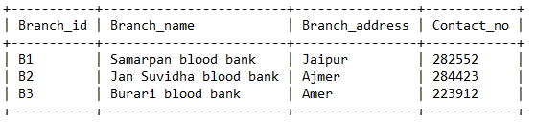
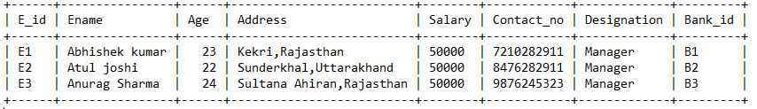
TABLES :
BLOOD BANK
EMPLOYEE

Slide 22
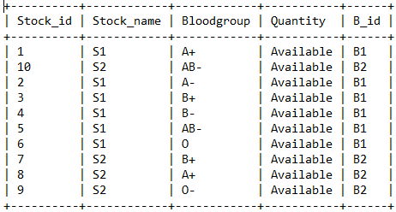
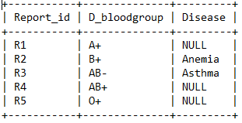
TABLES (Contd.) :
STOCK
MEDICAL REPORT

Slide 23
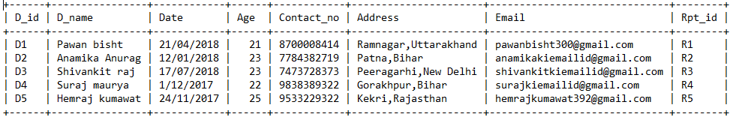
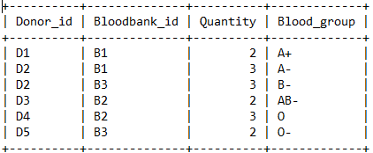
TABLES (Contd.) :
DONOR
DONATES

Slide 24
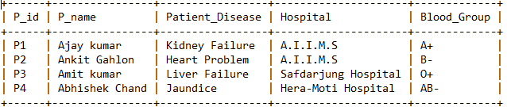
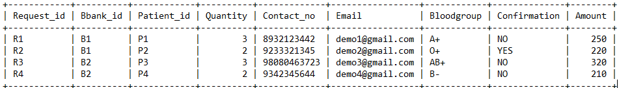
TABLES (Contd.) :
PATIENT
BLOOD REQUEST

Slide 25
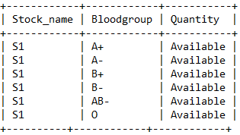
TEST CASES :
Display the detail of the donor who has their age in range 21-25.
SELECT * FROM donor WHERE D_id BETWEEN 21 AND 25 ;
Display the stock in S1 of blood bank B1.
SELECT Stock_name ,Bloodgroup ,Quantity FROM Stock WHERE Stock_name = ‘S1’ AND B_id = ‘B1’;

Slide 26
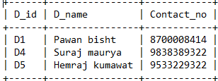
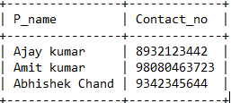
TEST CASES (Contd.) :
Display the id ,name ,contact number for the donor who don’t have any disease.
SELECT D_id ,D_name ,Contact_no FROM donor WHERE Rpt_id IN (SELECT Report_id FROM medical_report WHERE Disease = 'NULL');
Display the name , contact number of the patient who are not payed their amount yet.
SELECT patient.P_name ,blood_request.Contact_no FROM patient INNER JOIN blood_request ON patient.P_id = blood_request.patient_id WHERE blood_request.Confirmation = 'No' ;

Slide 27
CONCLUSION :
The aim of BLOOD BANK MANAGEMENT SYSTEM is to create a bridge between the demand and supply of blood.
The main purpose of this system is to bring the donor and the patient in a common platform.
The most important view point of this system is for men and women who are willing to donate blood to the patients.
It will encourage new donors and retain old donors to donate blood.
This system is designed to overcome the problems of the existing system. For every blood demand request it will improve the efficiency of data communication within the supply chain

Slide 28
REFERENCES :
Fundamentals of Database Systems , Ramez Elmasri , University of Texas at Arlington
https://www.pearson.com/us/higher-education/program/Elmasri-
Fundamentals-of-Database-Systems-7th-Edition
Tutorial Points : https://www.tutorialspoint.com/database_tutorials.htm
You tube :
Sanchit Jain https://www.youtube.com/watch?v=eTiPH9GQ30&list=PLmXKhU9FNesR1rSES7oLdJaNFgmuj0SYV

Slide 29

THANK YOU

